Slide 1
Rhode Island Office of the Attorney General
Elder Abuse Unit

Slide 2
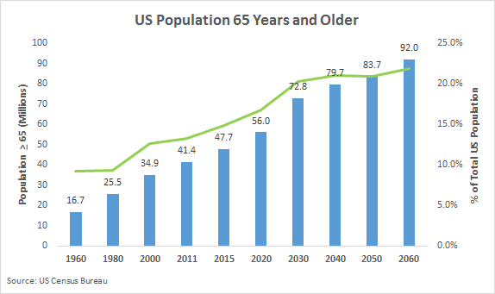
United States is an Aging Population
2015: 47.7 million people age 65 and older
2060 projected population people age 65 and older is 90 million!

Slide 3
Statistics on Elder Abuse
Abused seniors are 3 TIMES more likely to die than non-abused seniors.
Cognitive decline is a risk factor for elder abuse, including financial exploitation.
Approximately 1 in 10 seniors is abused each year.
Elder abuse is dramatically underreported. Only 1 in every 23 cases is reported to Adult Protective Services.
Source: Dept. of Justice, Elder Justice Initiative

Slide 4
Forms of Elder Abuse
Financial Exploitation
Physical Abuse
Emotional/Psychological
Sexual Abuse
Abandonment
Neglect

Slide 5
Financial Abuse
Scams
Lottery, Sweepstakes Scams
Grandparent Scam
Work from Home Schemes
Tax Scams
Phishing Scams
Romance Scams

Slide 6
Elder Abuse Unit Statistics
2018-
125 Superior Court cases opened
126 Disposed cases
Resulting in a total of 32.5 years to serve
$185,035.18 ordered in restitution

Slide 7
Rhode Island General Laws
Title 11, Criminal Offenses
Title 42-9.2, Office of the Elder Justice Prosecution Unit

Slide 8
Moving Forward
Preventative Education
Older Adults
Medical Professionals, including home health aides
Law Enforcement
Evaluation of Current Laws
Banking Rules and Regulations
National Background Checks
Probate Courts
Information sharing among relevant agencies and providers

Slide 9
Molly Kapstein Cote
Special Assistant Attorney General
(401) 274-4400, ext. 2032
mcote@riag.ri.gov
Mickaela Driscoll
Elder Abuse Investigator
(401) 274-4400, ext. 2383
mdriscoll@riag.ri.gov

